Slide 1
Final Project | Business Case: Building a Multimodal AI ChatBot
🌱GrowGuide🌱
Daan Booy
19/09/2025 Ironhack Bootcamp

Slide 2
INDEX
1
Project Overview
2
Data Preparation
3
Tools
4
4
???
Agent
5
5
Deployment
Evaluation
6
Chatbot Deployment

Slide 3



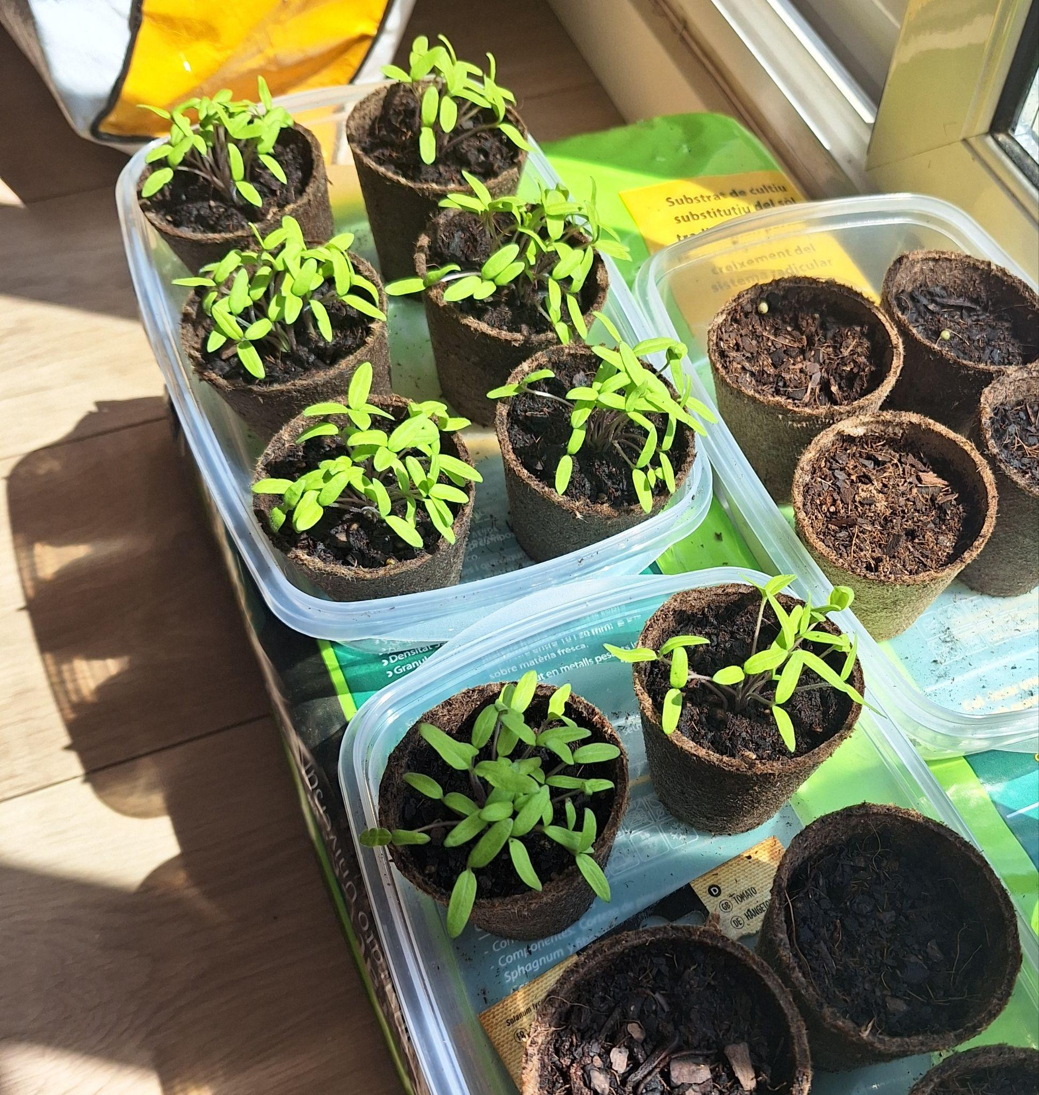
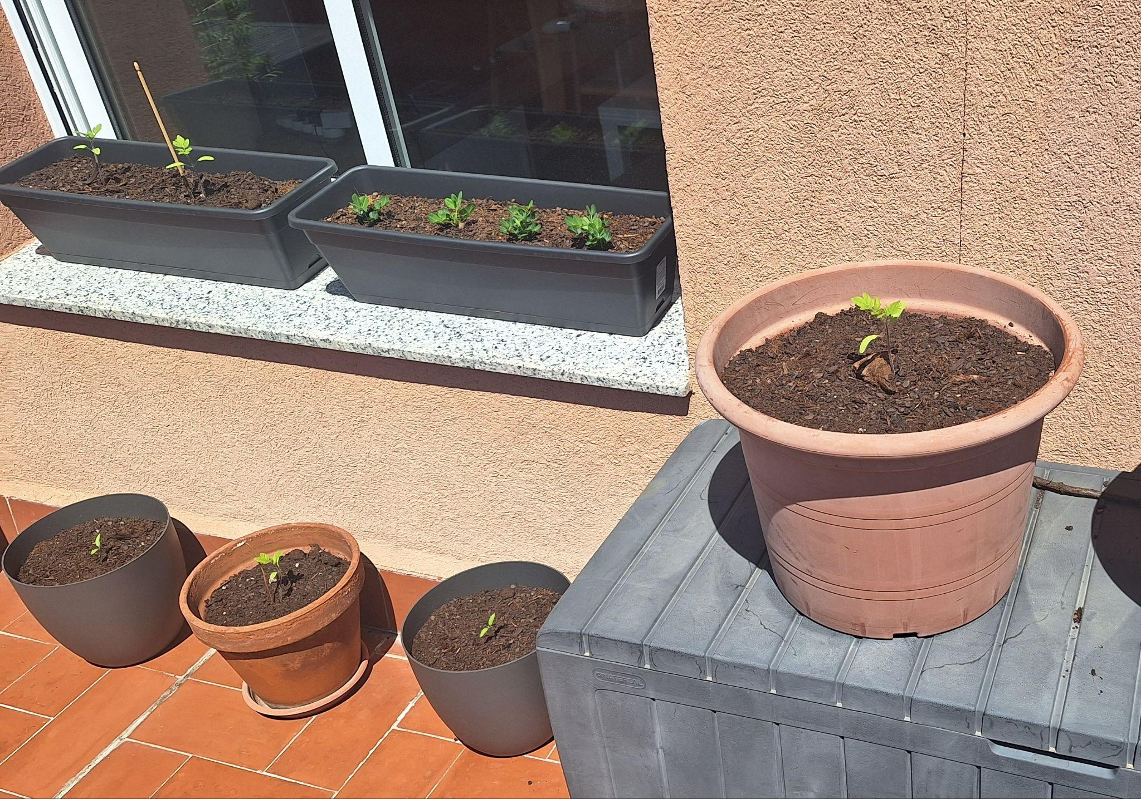
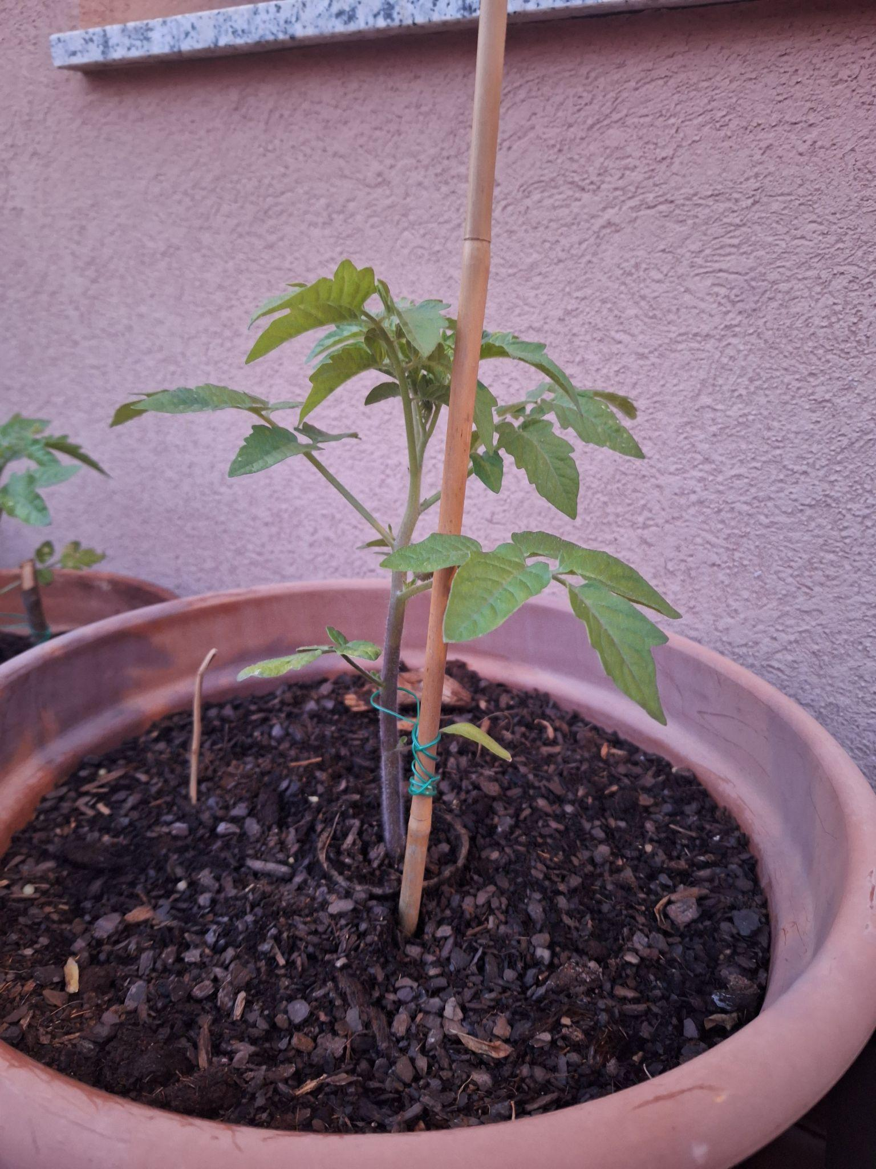
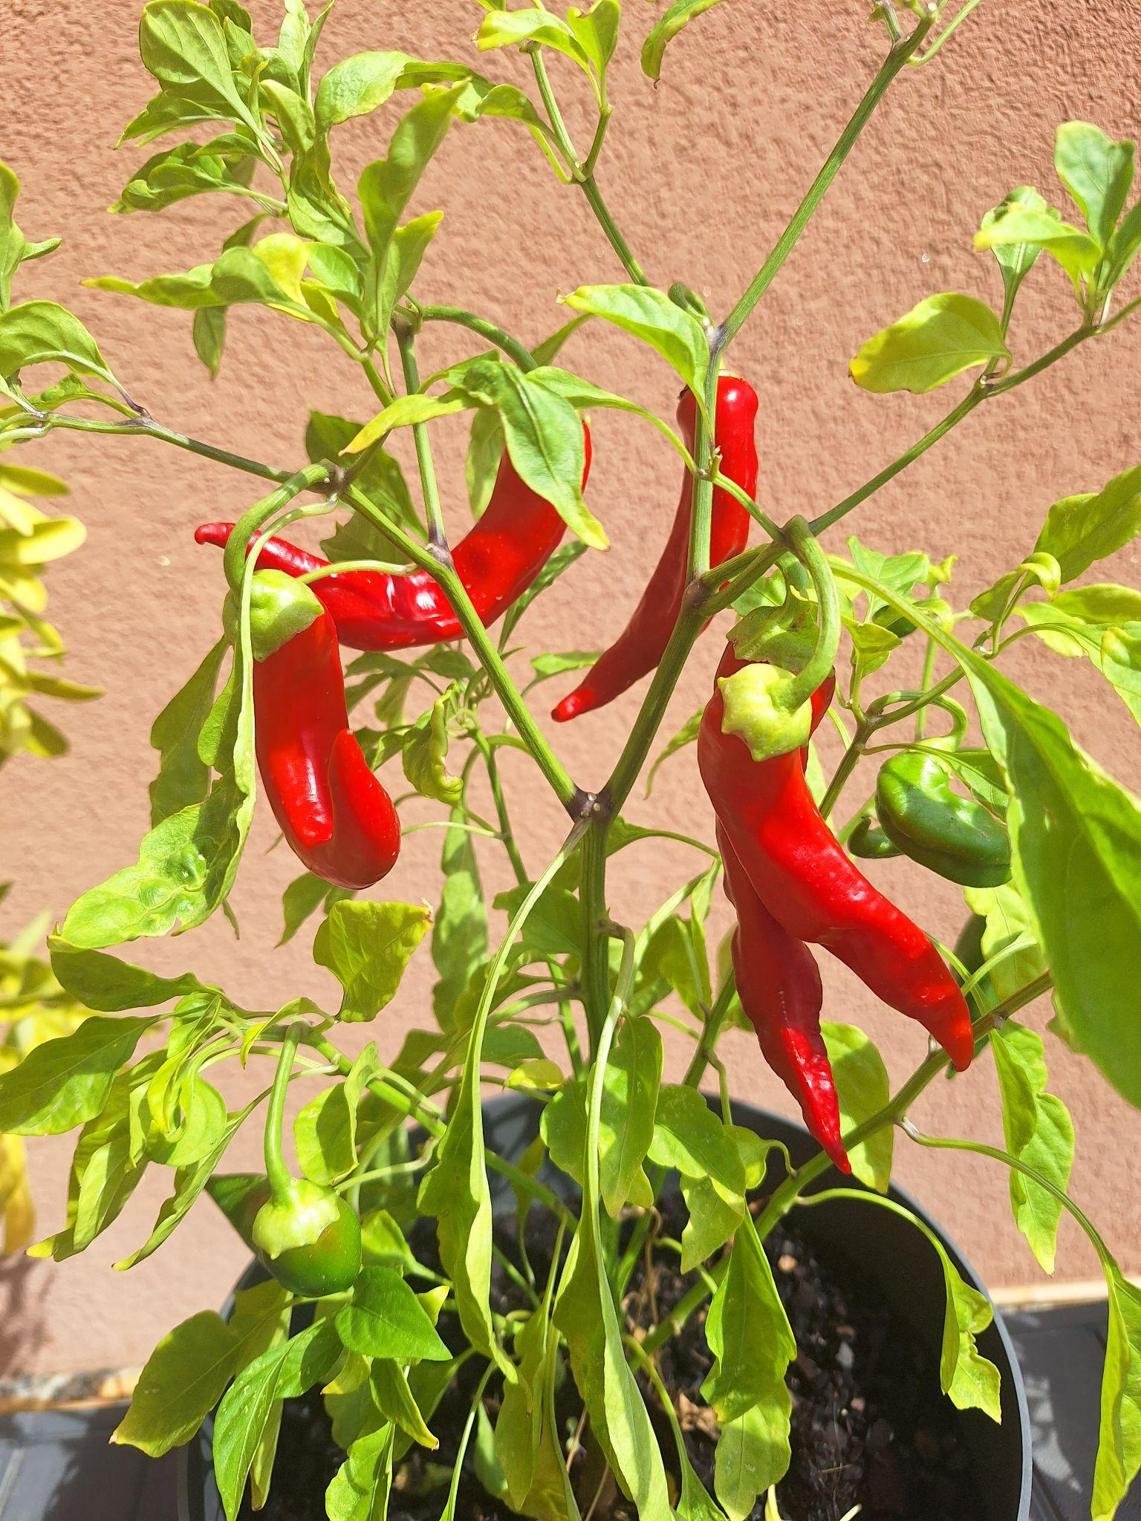
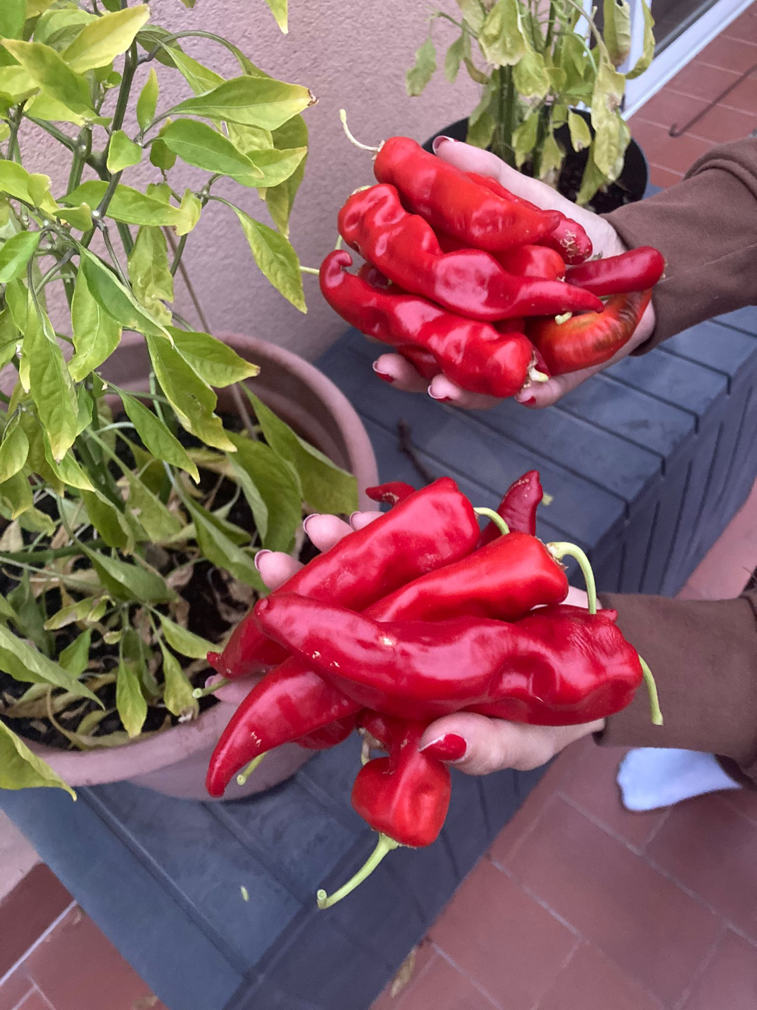

1 Project overview
The goal of the project is to develop a RAG system/AI bot that can answer questions about a chosen subject. The bot should be able to retrieve information out of a self made database, use tools and have session memory. The Bot also needs to be trackable and deployed, and allow for speech to text input and text to speech output.
Project tasks
Collect/clean/store relevant data for the chosen subject
Develop a full QA chain of the chatbot agent that uses multiple tools and memory
Deployment of the chatbot with STT and TTS
Chosen Subject: Growing fruits and vegetables at home.
‹#›

Slide 4
INDEX
1
Project Overview
2
Data Preparation
3
Tools
4
4
???
Agent
5
5
Deployment
Evaluation
6
Chatbot Deployment

Slide 5
2 Data preparation
1
2
3
4
Collecting data
Data cleaning
Data structure
Vector storage
Used data from articles and websites.
Scraped, but due to some difficulties also some manual copy pasting to txt file.
See example next slide.
Very simple data cleaning, because of knowledge of Data set.
Cleaned the text by:
Normalizing unicode
Normalizing spaces
Trimming blank lines
Segmented to 3 main categories > multiple sub categories > 84 docs.
Chunked to 350 docs
Embedding with: sentence-transformers/all-MiniLM-L6-v2
Used ChromaDB for vector storage. And not e.g. Pinecone, as this make more sense due to:
- Size
- Speed
- Costs
- Local
‹#›

Slide 6
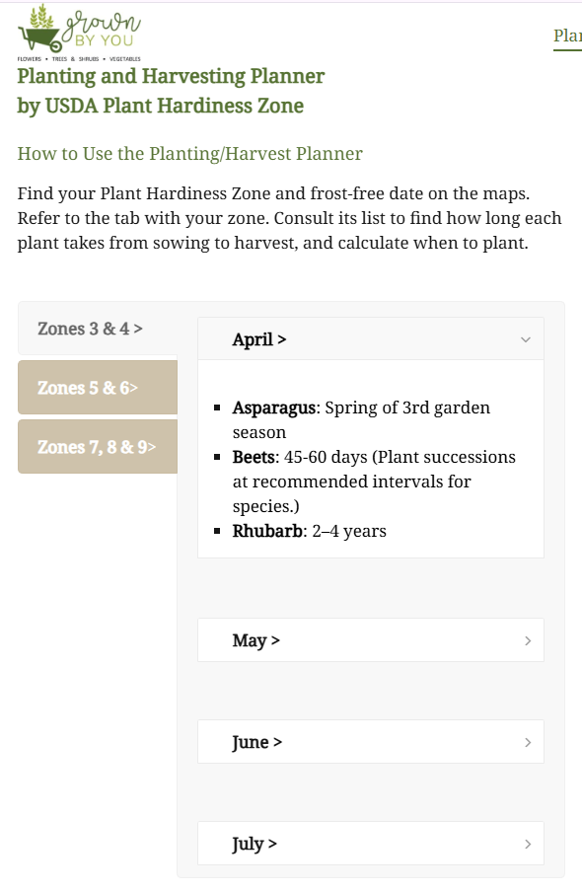
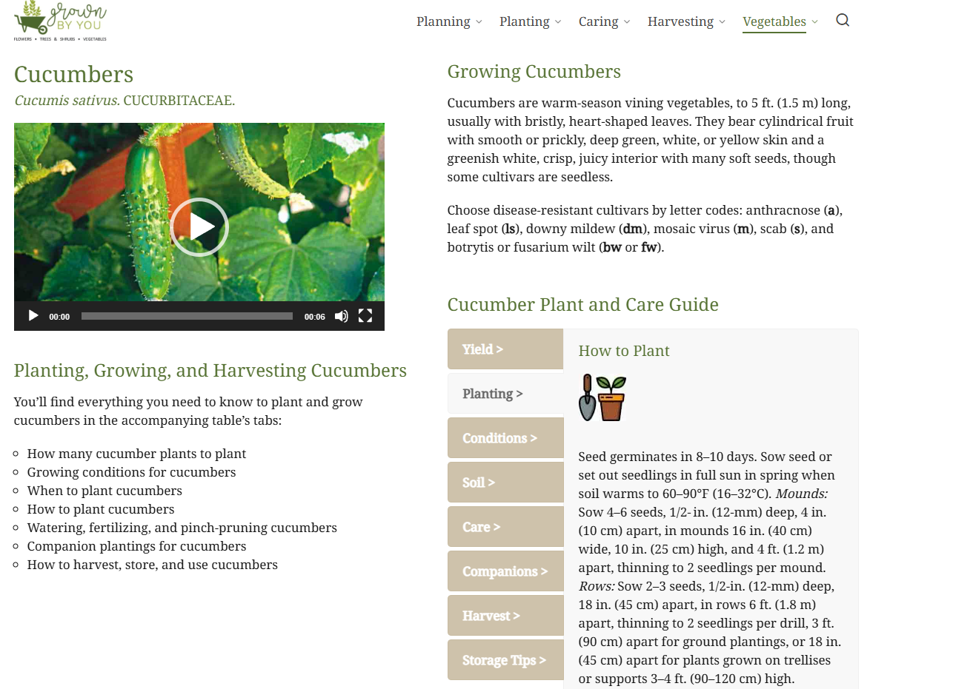
2.2 Data source
‹#›

Slide 7
INDEX
1
Project Overview
2
Data Preparation
3
3
Review classification
Tools
4
4
???
Agent
5
5
Deployment
Evaluation
6
Chatbot Deployment

Slide 8

3.1 Tools - Self Query Retrieving
Example:
Simple retriever was decent, but there was room for improvement.
Gave good top results but also some noise.
Simple Retriever
Q: Companion plants for tomatoes
-> {'crop': 'cooking, saucing, and paste tomatoes', 'category': 'vegetable_list'}
-> {'category': 'vegetable_list', 'crop': 'cherry, grape, or miniature tomatoes'}
-> {'crop': 'romaine lettuce or cos', 'category': 'vegetable_list'}
-> {'category': 'vegetable_list', 'crop': 'eggplant or aubergine'}
Self query retriever gave better results.
Uses LLM (gpt-4o-mini) to retrieve vectors from storage.
Inform about structure and what can be expected.
LLM can then skip directly to correct part of storage.
Self Query Retriever
Q: Companion plants for tomatoes
-> {'category': 'vegetable_list', 'crop': 'cooking, saucing, and paste tomatoes'}
-> {'crop': 'cherry, grape, or miniature tomatoes', 'category': 'vegetable_list'}
-> {'crop': 'cherry, grape, or miniature tomatoes', 'category': 'vegetable_list'}
-> {'crop': 'cooking, saucing, and paste tomatoes', 'category': 'vegetable_list'}
-> {'category': 'vegetable_list', 'crop': 'slicing or eating tomatoes'}
-> {'category': 'vegetable_list', 'crop': 'husk tomatoes and ground cherries'}
‹#›
‹#›

Slide 9
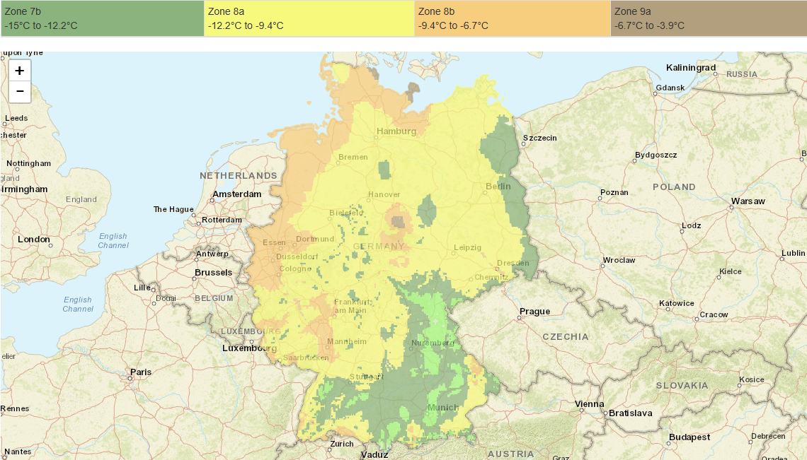
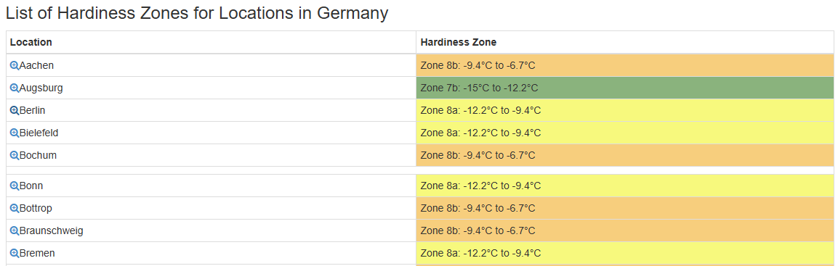
3.2 Tools - Climate zone lookup (USDA Hardiness Zone)
SerpAPI
Using SerpApi to search the USDA Hardiness zone for the city that the user has entered.
With bias for plantmaps.com
Page reading
Making the webpage into plain text, to help retrieve the correct value from the found website.
‹#›

Slide 10
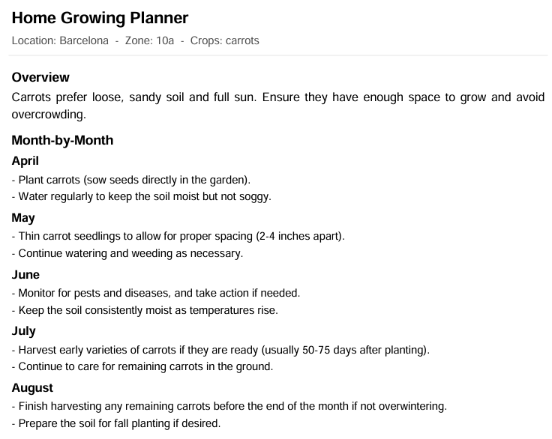
3.3 Tools - PDF generation
Used the FPDF tool
Which can be used for PDF Generation
Configured to:
Make a personalized month by month planning.
Uses the input question and if needed session memory.
Takes into consideration:
Your location / climate zone
Requested crop
Requested start month (if None, then the more optimal)
Adds additional notes if needed.
Returns as downloadable link in the chat.
‹#›

Slide 11
INDEX
4
1
???
Project Overview
2
Data Preparation
3
Tools
4
4
4
Agent
???
Product Category Clustering
5
5
Deployment
Evaluation
6
Chatbot Deployment

Slide 12
4.1 Agent
The tools were wrapped into the agent, which makes use of session memory to maintain context across interactions. When required, it incorporates climate zone information and supports PDF generation.
Model used is: gpt-4o-mini
PROMPT
"You are a helpful home-growing assistant.\n"
"TOOLS:\n"
"• growguide_answer — Use for most Q&A. It runs the RAG QA chain (self-query retriever) and returns a ready answer.\n"
"• search_growguide — Use when you need raw snippets to assemble tasks_by_month for a PDF planner.\n"
"• find_hardiness_source + read_zone_from_url — Use to determine a location's hardiness zone.\n\n"
"Guidance:\n"
"1) If the user asks for their hardiness zone: call 'find_hardiness_source' with the location, then "
"'read_zone_from_url' with that URL (and the location) to extract the zone; remember it in this chat.\n"
"2) For normal growing questions: call 'growguide_answer' with the user's question (include any known zone/crop/months).\n"
"3) If a full planner/PDF is requested: call 'search_growguide' to fetch snippets, build tasks_by_month (month -> [task,...]), "
"then call 'make_planner_pdf' with location, zone (if known), tasks_by_month, optional crops, and notes. Use ASCII/latin-1 text.\n"
"4) Keep answers focused and brief. Directly answer the user's question **only**. Prefer 1–4 sentences or a short bullet list. "
"Avoid extra detail unless asked; instead, offer a follow-up like: "
"\"I can share more detail (e.g., step-by-step or month-by-month tasks) if you’d like.\"\n"
"5) Stay in scope: home gardening of fruits/vegetables, hardiness climate zones, and printable planning PDFs. "
"If a request is outside this scope (e.g., gaming, finance, unrelated tech), reply briefly: "
"\"Sorry, that’s outside my expertise. I can help with home fruit & vegetable growing, climate zones, and personalized planning.\""
‹#›

Slide 13
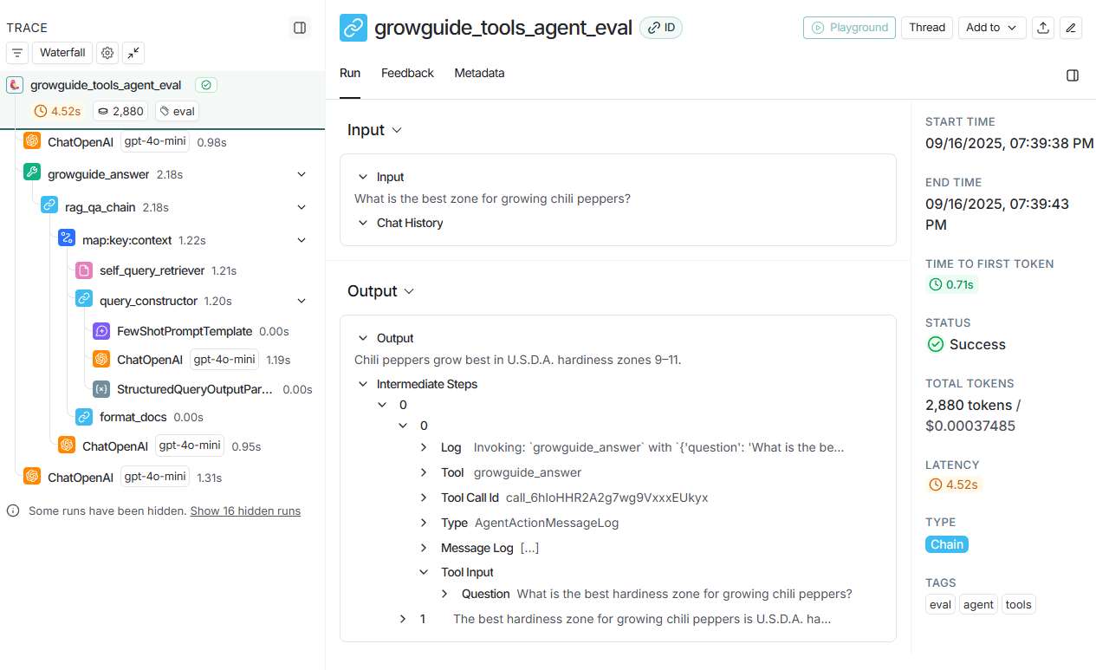
4.2 LangSmith tracking
LangSmith tracking
Low cost > $0.0001 to $0.0005 per run
Response time > normally between 5 to 12 seconds. But can occasionally be up to 30-40 seconds
‹#›

Slide 14
INDEX
5
1
Deployment
Project Overview
2
Data Preparation
3
Tools
4
4
???
Agent
5
Evaluation
6
Chatbot Deployment

Slide 15
5 Evaluation
Used a large language model as a judge, the mode used was gpt-4o-mini. The judge and agent were provided with the same context that was retrieved from the self-query retriever. The evaluation was done with ten test questions, and repeated three times.
Correctness: factual accuracy
Example:
Q: What is the best zone for growing chili peppers?
Groundedness: supported by the provided context
Relevance: addresses the question
Completeness: covers the key steps/details expected
Run 1:
Answer: Chili peppers thrive best in USDA hardiness zones 9–11. They are tender perennials and should be protected from temperatures below 55°F (13°C) for extended periods. If you're in a cooler climate, consider overwintering them indoors once they become semi-dormant.
Conciseness: clear and not verbose
Consistency: similarity of outputs (repeats)
Evaluation results (mean)
Run 2:
Answer: Chili peppers thrive best in USDA hardiness zones 9–11. They are tender perennials and should be protected from temperatures below 55°F (13°C) for extended periods. If you're in a cooler climate, consider overwintering them indoors once they become semi-dormant.
Correctness 9.73
Groundedness 8.8
Relevance 9.87
Run 3:
Completeness 8.53
Conciseness 8.87
Consistency 8.1
Answer: Chili peppers generally thrive in USDA hardiness zones 9 to 11, where the climate is warm and frost-free. They prefer temperatures between 70°F and 90°F (21°C to 32°C) for optimal growth.
‹#›

Slide 16
INDEX
5
1
Deployment
Project Overview
2
Data Preparation
3
Tools
4
4
???
Agent
5
5
Deployment
Evaluation
6
6
Model deployment
Chatbot Deployment

Slide 17
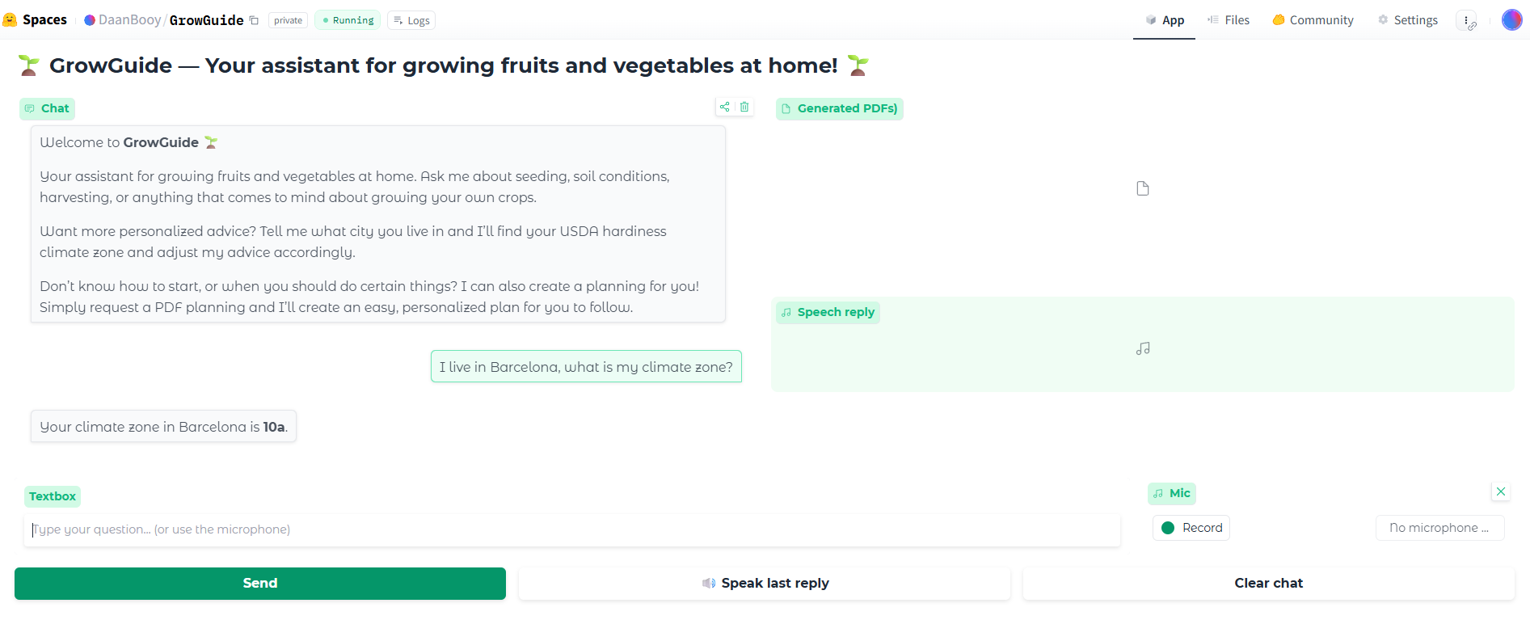
6 Chatbot Deployment
Used HuggingFace Spaces for the deployment.
Converted the the necessary agent code to a .py file.
Made a .py app file for Gradio, to setup the interface and interaction with the agent file. And to adjust to theme.
Interactable components:
The chat to ask fruit and vegetable related growing tips.
Speech to Text input & Text to Speech output
Download the generated plannings.
https://huggingface.co/spaces/DaanBooy/GrowGuide
‹#›

Slide 18
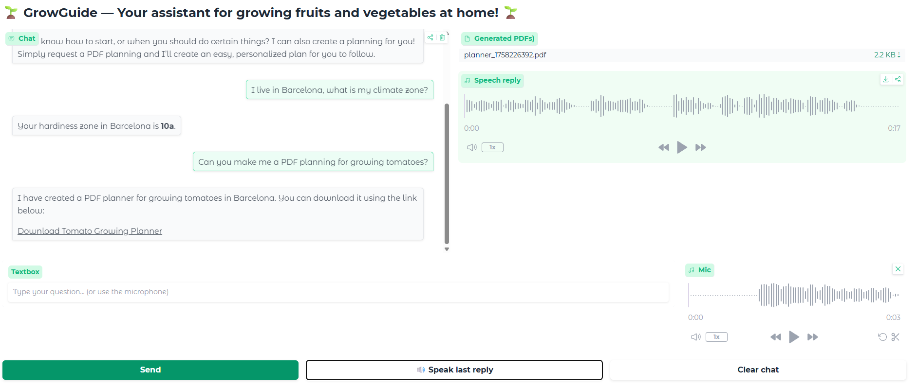
https://huggingface.co/spaces/DaanBooy/GrowGuide
‹#›

